Slide 1




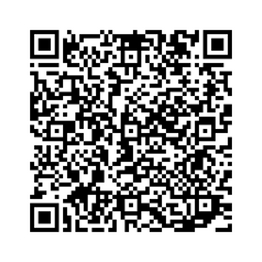

NOTE FOR THE
COALITION NEGOTIATORS
DECEMBER 9 12:00
NATIONAL HIGHER
EDUCATION STRIKE DAM SQUARE
AMSTERDAM
BUDGET CUTS TO HIGHER EDUCATION
INVESTING IN HIGHER EDUCATION
FNV.NL/HO

Slide 2
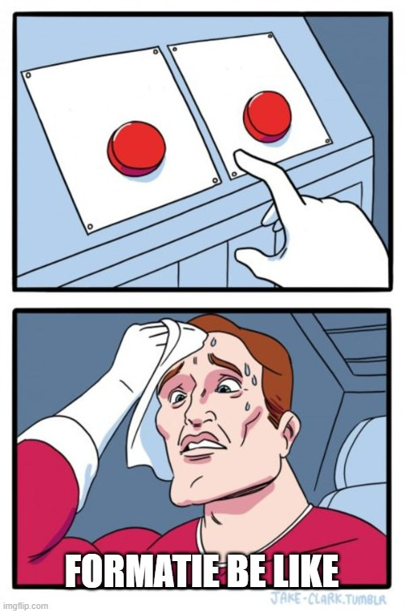
DECEMBER 9 12:00
NATIONAL HIGHER
EDUCATION STRIKE DAM SQUARE
AMSTERDAM
Investing
in higher
education
Bye bye degree programs
Sky-high workload
Hiring freeze and
layoffs
FNV.NL/HO

